Slide 1
NY Annual Market Data Analysis
File created on: 8/13/2025 12:23:44 PM

Slide 2
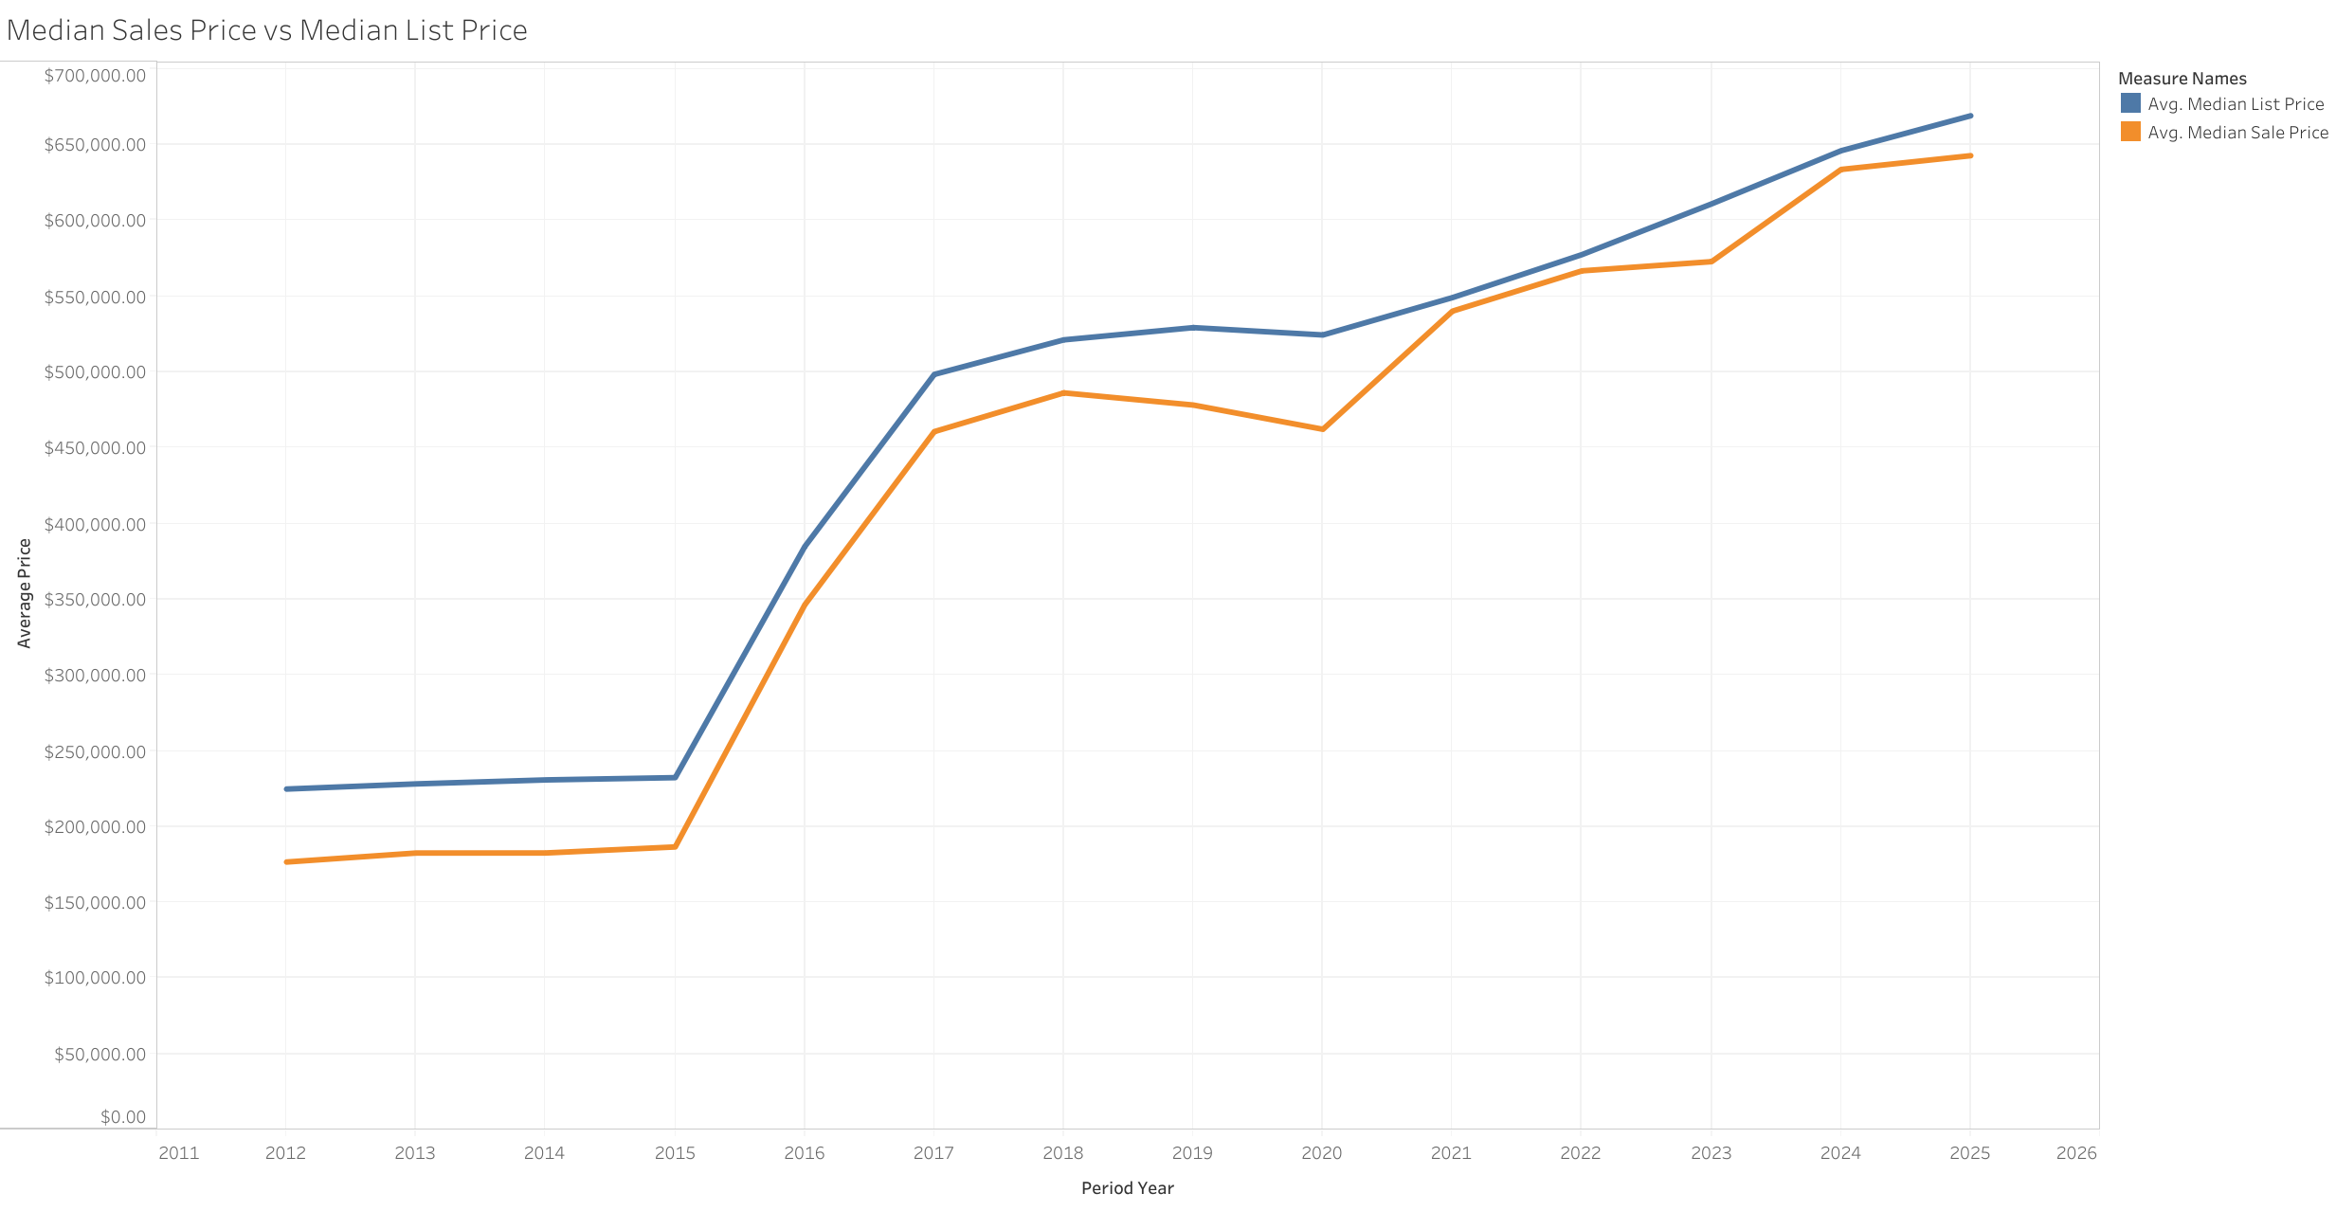

Slide 3
